Slide 1
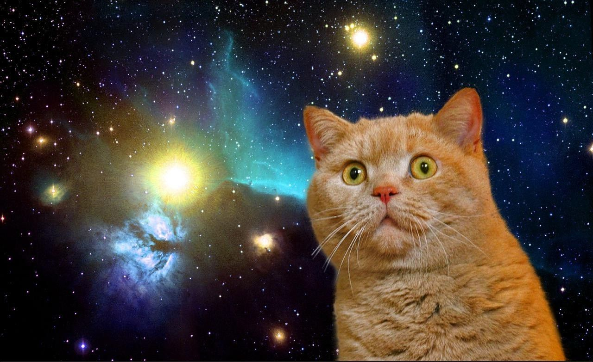
NASA space apps challenge demo edition
By Europlaneteterre

Slide 2
What is the project?
We are creating the orrery webapp project ad it is almost completed.

Slide 3
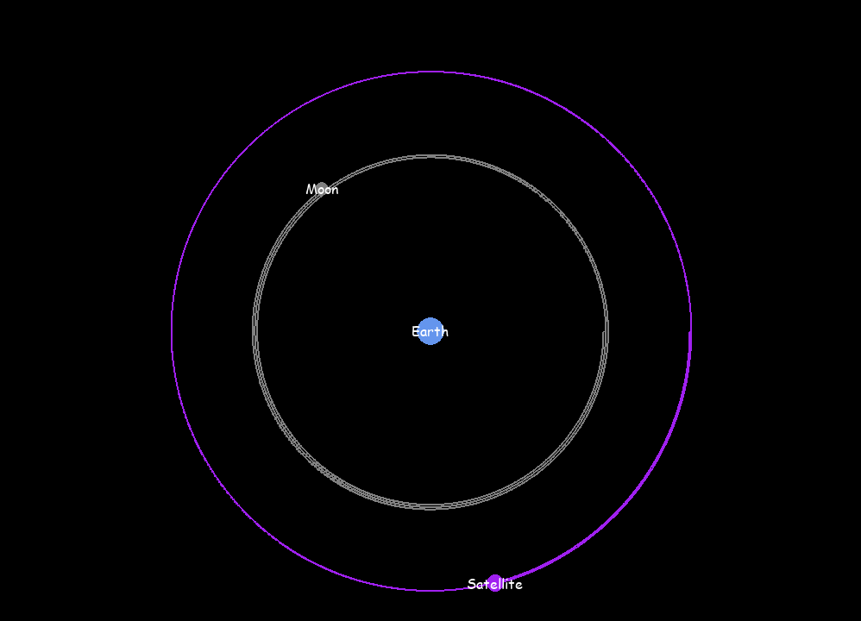
Images of the project.

Slide 4
Thank you

